Slide 1


Mini Project
Project Submission
Due Friday, june 27th at 1:00pm

Slide 2

PLAN
Problem
Methodology
Results
Proposed solution
References and appendices
Team members

Slide 3


Problem
Ayiti Analytics Data wants to expand its training centers throughout all the communes of the country.
Its objective is to know which three communes of the country will be the most likely to expand its training centers.

Slide 4
Stakeholders
Ayiti Analytics (the project)
The projects needs to be extended, so a lot of people have to know about this event
Companies and business
When those companies will need a data scientist, they might not be able to find one qualify to do the analysis that a data scientist does

Slide 5


Methodology
Firstly, we will collect data for the analysis. We will use the data related to the list of applications, to the communes, and to which channel the news were spread, to the people who have paid to be enrolled in the bootcamp, either by moncash or paypal/credit card

Slide 6


Methodology
Secondly, we will use Python to manipulate the data. We will start by treating the data and then we will look for the quantity of applicants by communes, who actually pay for the online course “ entwodiskyon nan syan done”, people who pay for the course how they heard about Ayiti Analytics

Slide 7


Methodology
And then, we will use mathematics and statistics tools such as average, sum, trends to make calculations based on the people who apply for the bootcamp and people who pay to be part of the next step, and with more.

Slide 8
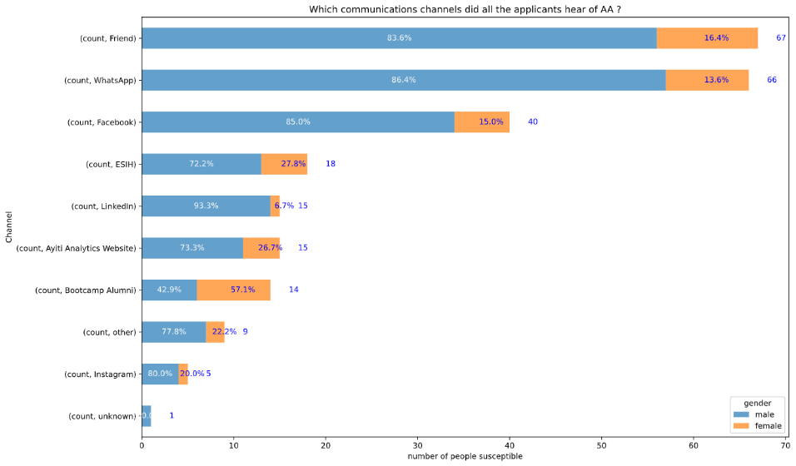
How all the applicants heard about Ayiti Analytic

Slide 9
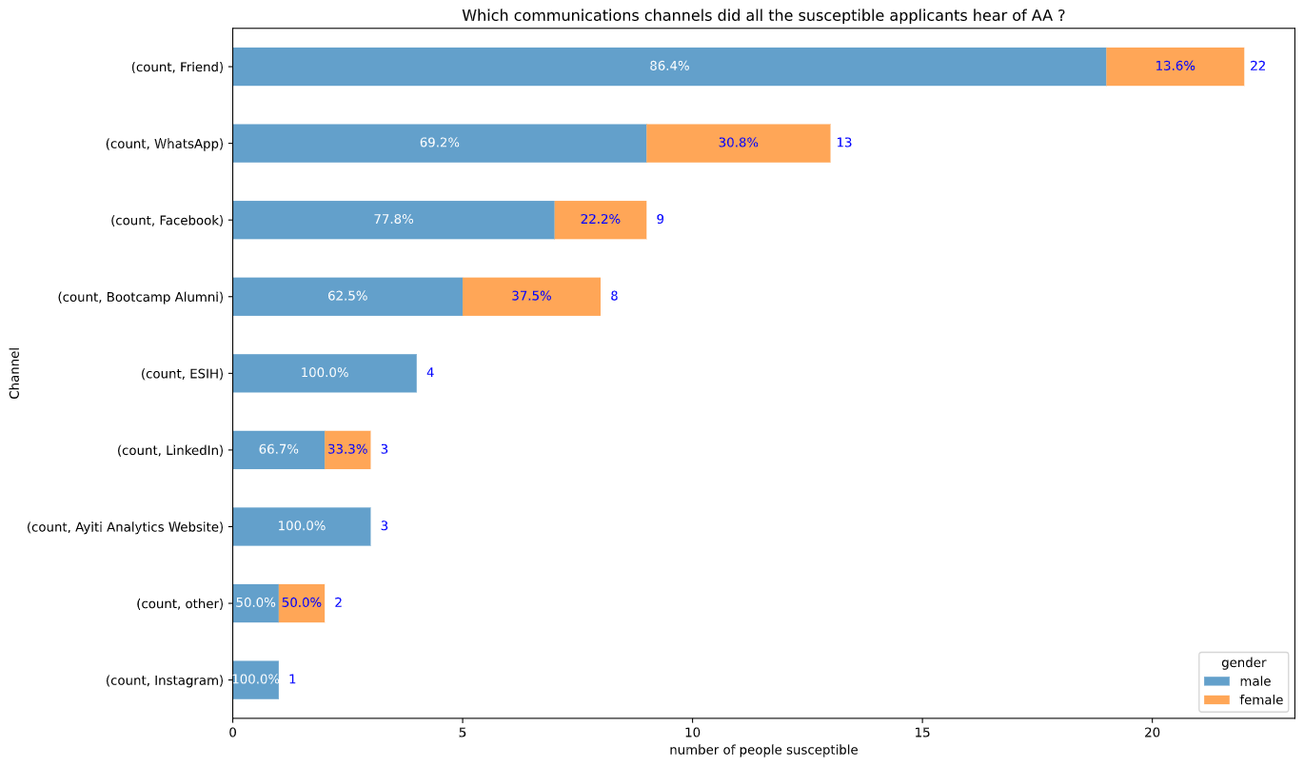
How people who susceptible to selection heard about Ayiti Analytics

Slide 10
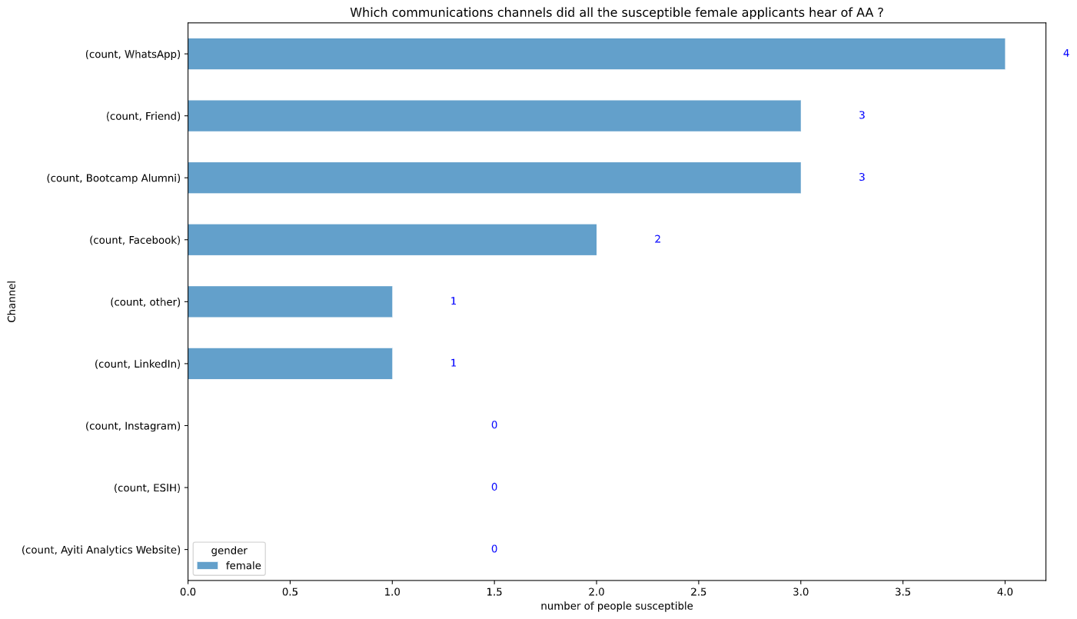
How female who are susceptible to selection heard about Ayiti Analytics

Slide 11
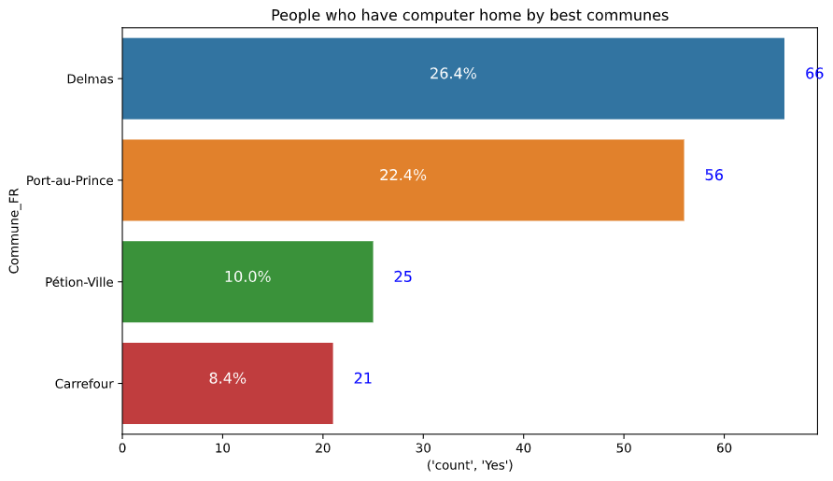
People who have computer by best communes
Beside of P au P , you can see delmas, petion ville, Carrefour, there are more people who have computer at their home

Slide 12
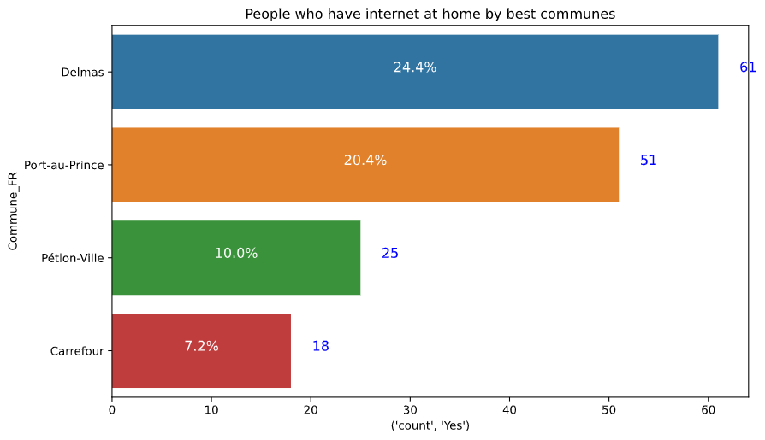
People who have internet by best communes
yu can see in petion ville in delmas in Carrefour, there are more people who have internet

Slide 13
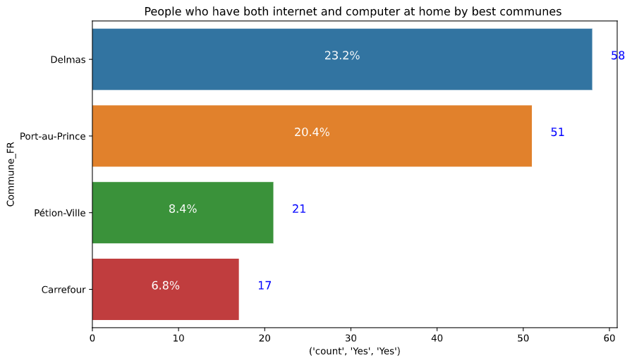
People who have both internet and computer by best commune
You can see that in delmas, petion ville, Carrefour, most applicants have both computer and laptop at the same time

Slide 14
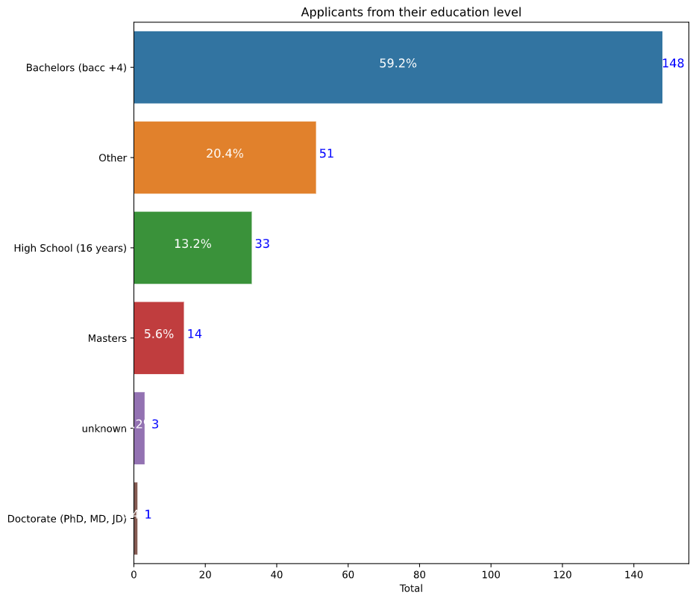
Applicants by education level
You can see that there are a lot people who apply in the bootcamp are in back+4

Slide 15
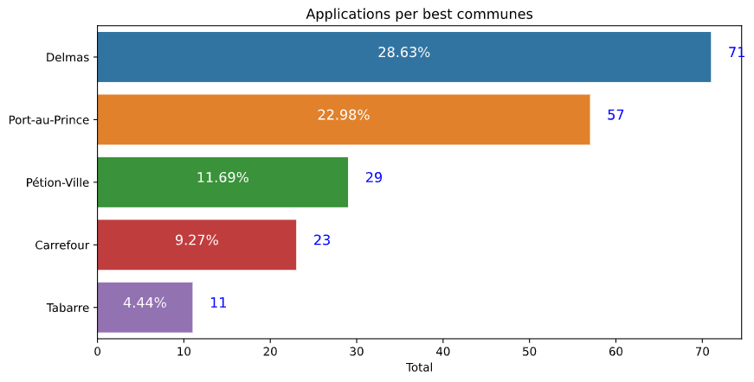
Applications by best communes
You can see that delmas , petion ville, Carrefour are the highest zone of applicants

Slide 16
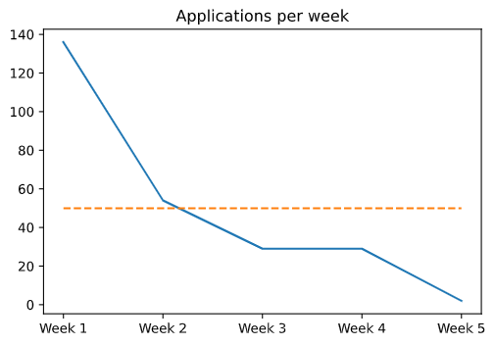
The flow of the people who apply by weeks
We can see that the number of applicants by week keep decreasing

Slide 17
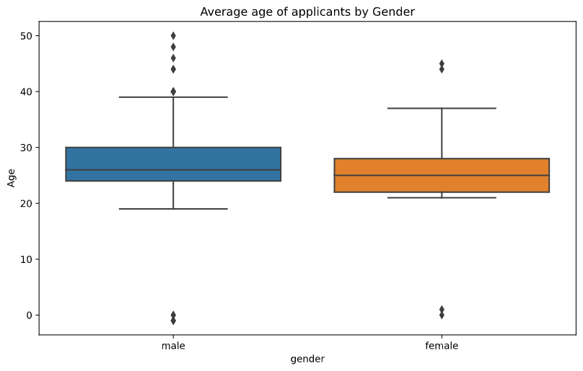
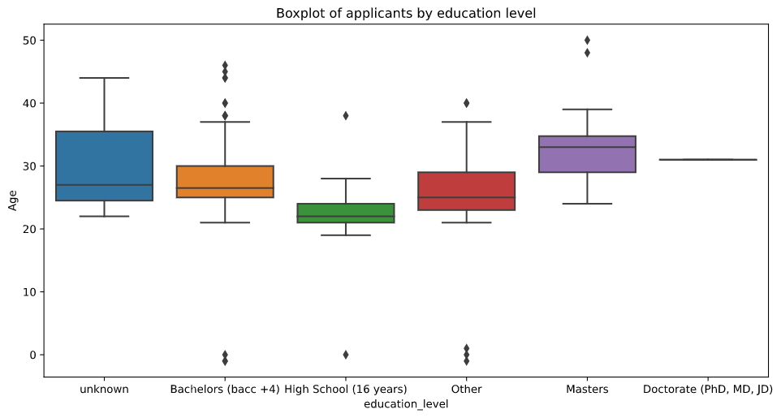
Quick overview in boxplot by Gender and education level

Slide 18
SWOT
Opportunities | Threats
Make the bootcamp online won’t need a lot of training centers They can use the result of the business analysis to see things in a different way where to expand A lot of companies in hait need Data scientist | Big Challenge in the domain of data scientist Data missing
Strengths | Weaknesses
Any education level can join Ayiti Analytics to learn Yu can join Ayiti Analytics if yu have at least 18 years old | The problem of electricity in the country Internet laguing, poor connection Wit the Covid-19 the bootcamp will not be favorable in centers

Slide 19
Proposed solution
Ayiti Analytics can expand his training center in delmas, petion ville, Carrefour. These are the town with the highest applicants, and applicants who have both internet and laptop
Ayiti analytics can do the bootcamp online, so every communes will be able to participate.
he won’t have to spend money in a center, for the teachers
and even the country is locked for covid or politics situation, they will
still be able to teach people

Slide 20
References & Appendices
www.marketsandmarketsblog.com
What is Business Analysis? | Global Standard for Business Analysis Certification | IIBA®
Strength, Weakness, Opportunity, and Threat (SWOT) Analysis Definition (investopedia.com)

Slide 21


Presentation
Jeffking STERILE

